Slide 1
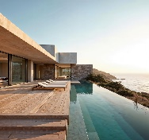
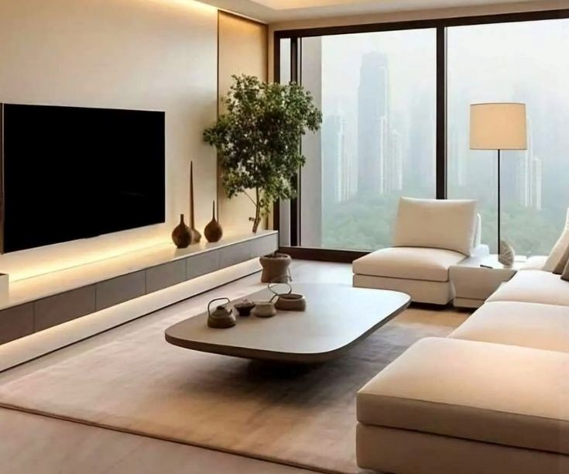





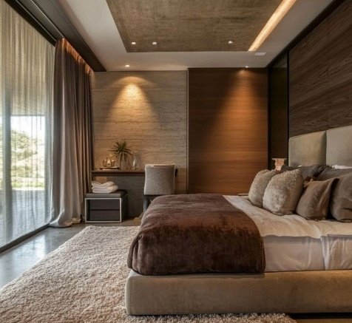
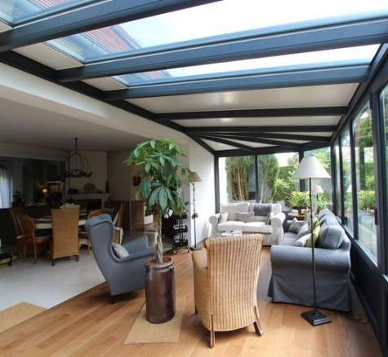










Fortico Smart Home
Tamatave, 501
3 Septembre
Thu. 11:22
My Home
70%
89%
25°C
Home
Bedroom
Live
FHD ˅
Veranda
Live
FHD ˅
Devices
Room
Add devices
Full screen
Full screen
Scène
Accès
Light
Settings
Ampoule led Ingelec

Slide 2
Fortico Smart Home
Tamatave, 501
3 Septembre
Thu. 11:22
My Home
70%
89%
25°C
Home
Bedroom
Live
FHD ˅
Veranda
Live
FHD ˅
Devices
Room
Add devices
Full screen
Full screen
Scène
Accès
Light
Settings
Ampoule led Ingelec

Slide 3
Color palette
#2A2A32
#07CEC9
rgb(42, 42, 50)
rgb(7, 206, 201)
#373742
#E6EAEE#E6EAEE
rgb(55, 55, 66)
#4A4A58
rgb(230, 234, 238)
rgb(74, 74, 88)

